Slide 1
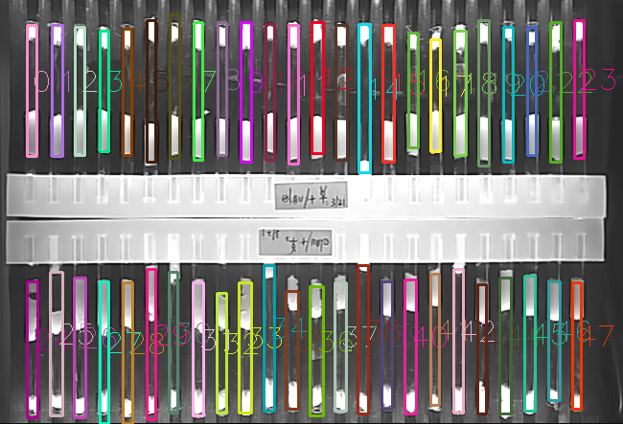
Objective
Automatically locate glass tube region with bounding boxes.

Slide 2
1. Dataset preparation
1-1
Collect raw samples
Script: collect.py
1-2
Create ready-to-use datasets
Script: dataset-func.hpp, createDataset.cpp
1-3
Preprocessing
Script: dataset-func.hpp, prepDataset.cpp

Slide 3
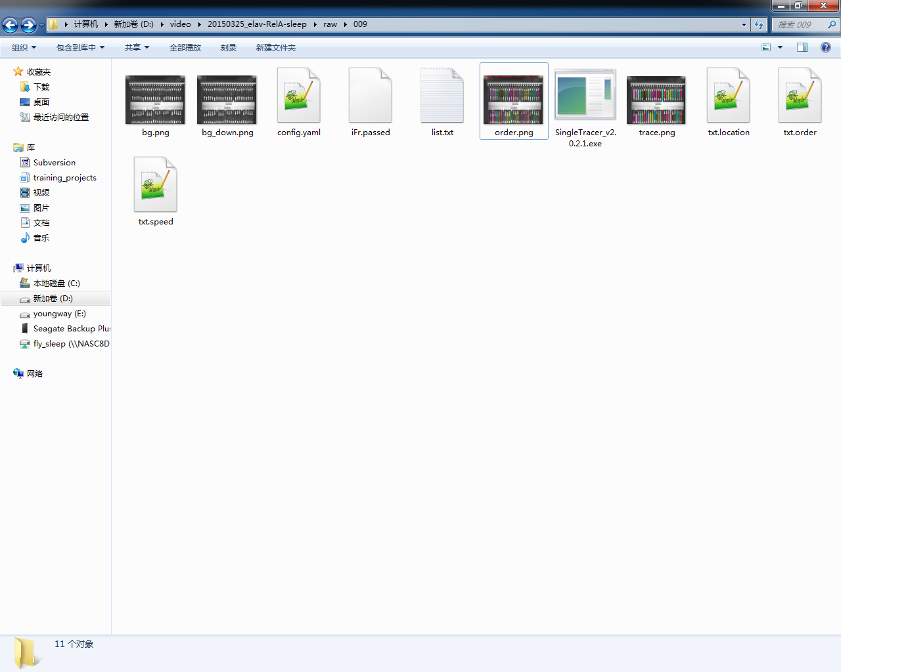
1-1 Collect raw samples
原始数据：原数据目录列表
原始数据：图像及标注文件名称

Slide 4
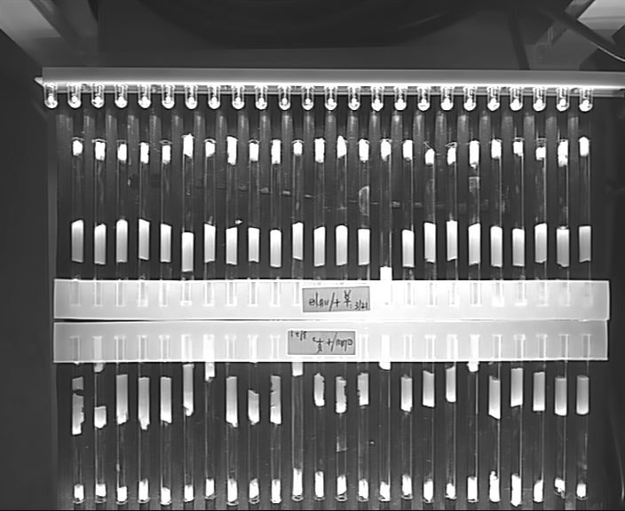
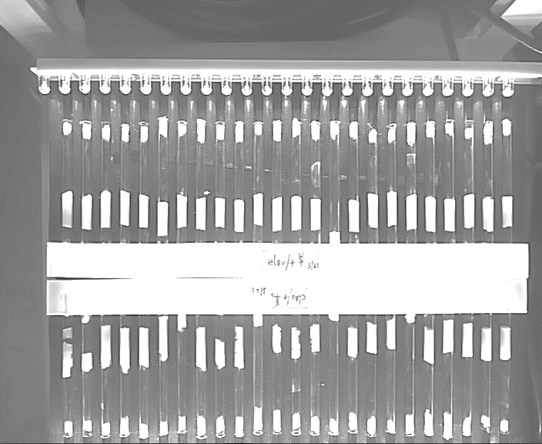
1-2 Create ready-to-use datasets
扩增数据：旋转，镜像及组合
height x width
线性堆叠：行向量化，堆叠成矩阵
m
…
归一化数据：尺寸、灰度、重心

Slide 5
2. Training prototype-1 (pixel-feature)
2-1
Split dataset
Script: splitDataset.m
2-2
Train with 4-layers FNN
Script: train-function series *.m, trainFnn.m
2-3
Cross-validation
Script: learningCurve.m, lambdaCurve.m, pCurve.m

Slide 6
3. Predict with prototype1 (pixel-feature)
Class predictor:
[input]: a gray image (bg.png)
[input]: model folder (containing Mu.mat, Sigma, Theta1, Theta2)
[input]: draw several sub-regions for detection
[output]: vector<Rect> rois; order.png
X
Image stack to be convoluted
Linearization
Input: 1001
Y-concatenation
50
hidden: 51
1001
1001
θ1
51
2
2
Output: 2
X
a1
51
θ2
y
m
m
m
…
…
θ2
θ1
Matrix multiplication in FNN
3Layer Feed-Forward Neural Network

